Slide 1
Preliminary Investigation of Field-Aligned Electrons in the Magnetosphere
C. Schiff – 2/17/16 v0.0

Slide 2
Status
Performed a preliminary scan through Quicklook Plots
Oct. 1st – Dec 1st
Looked for field-aligned structures in the medium energy band that occurs in the magnetosphere (or perhaps not in the magnetosheath)
Noted candidate dates and ‘drilled down’
Oct 4 10:00-18:00
Oct 5 – 14:00-18:00
Nov 4 – 02:00-04:00; 06:00-08:00
Nov 12 – 02:00-04:00

Slide 3
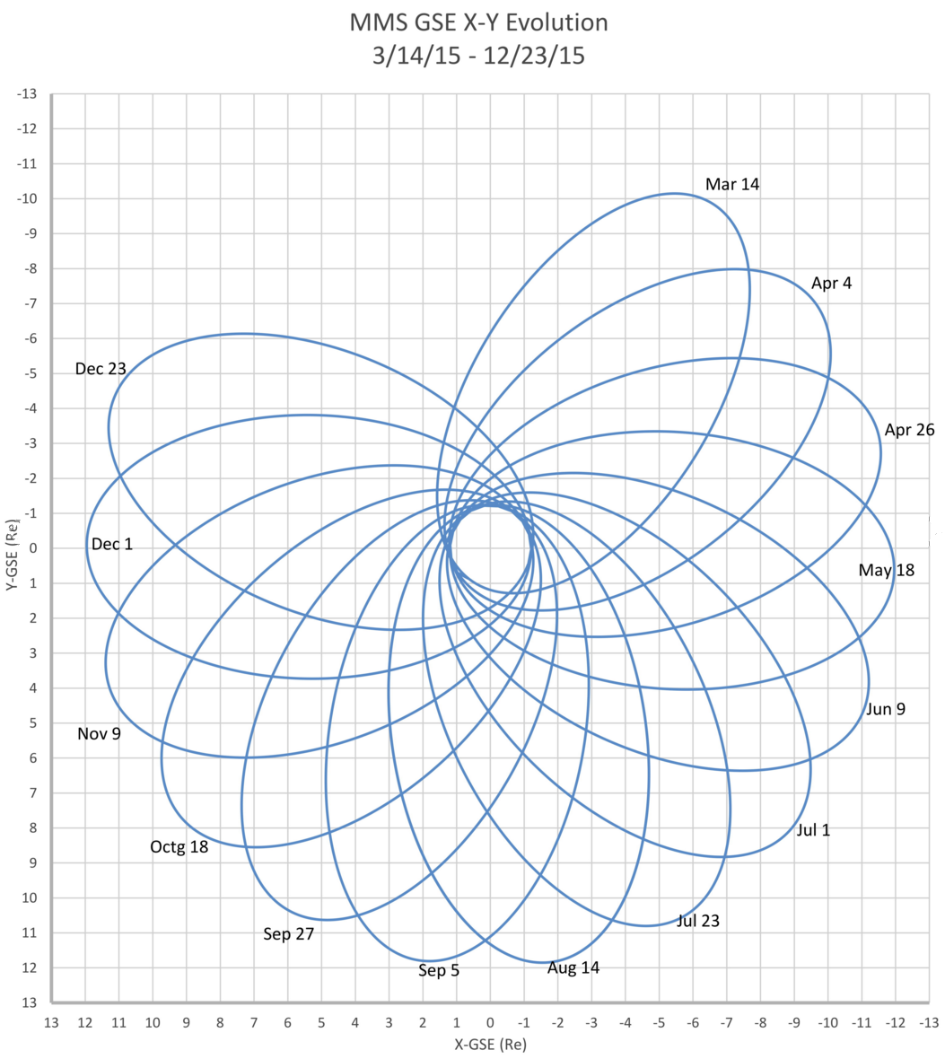
Orbit Geometry and Approximate Candidate Location
11/12
11/4
10/4-5

Slide 4
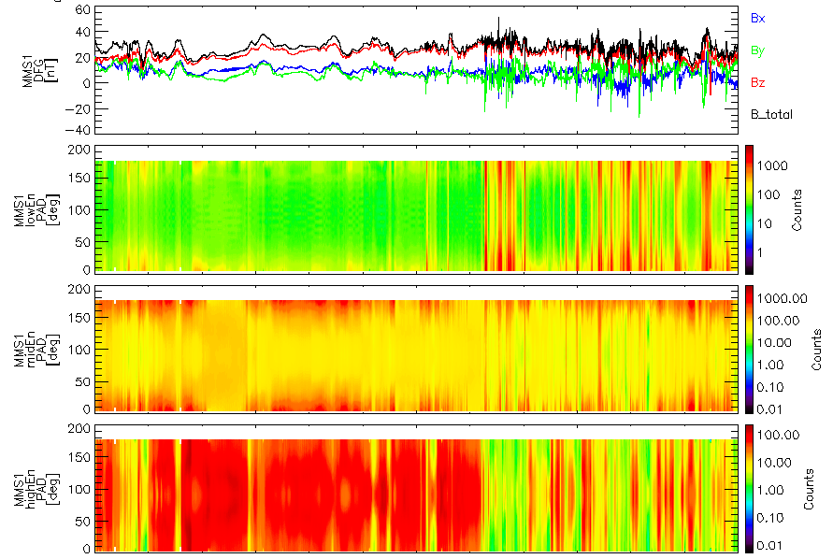
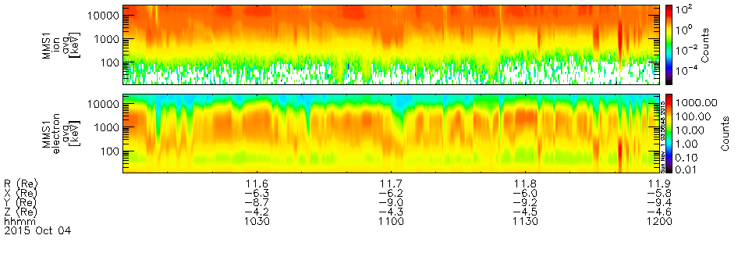
Oct. 4 – 10:00-12:00

Slide 5
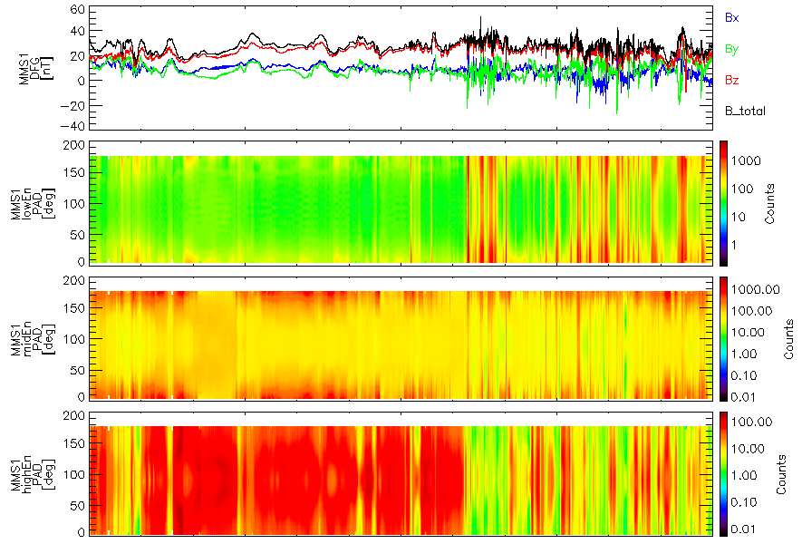
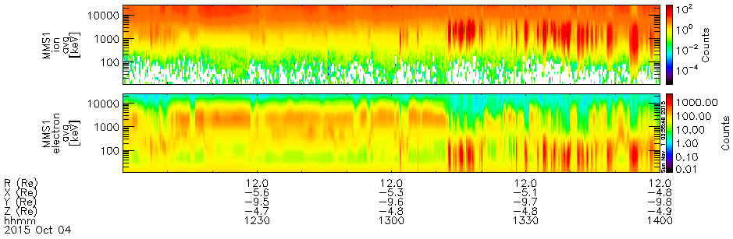
Oct. 4 – 12:00-14:00

Slide 6
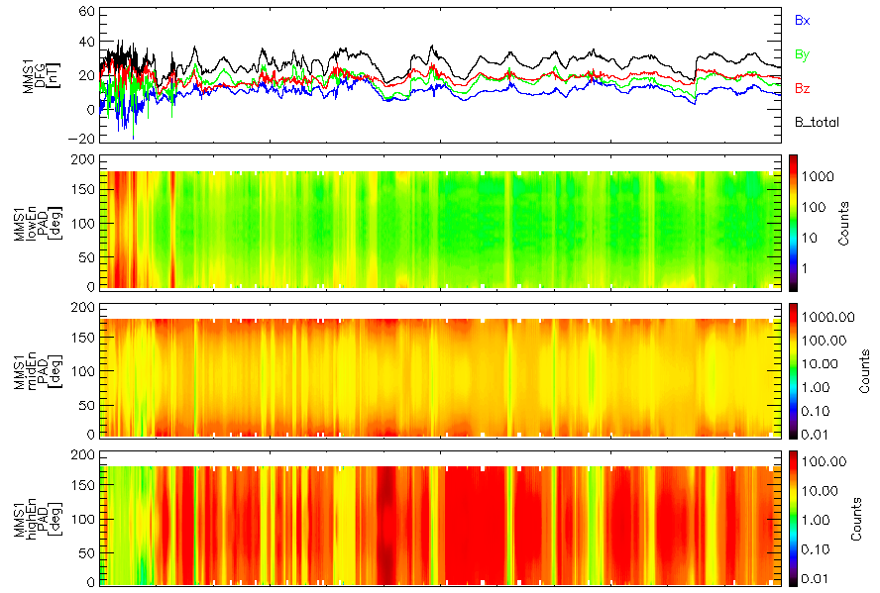
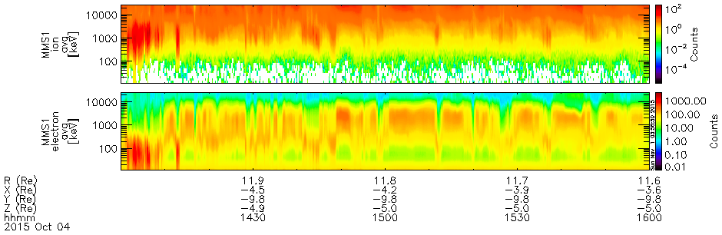
Oct. 4 – 14:00-16:00

Slide 7
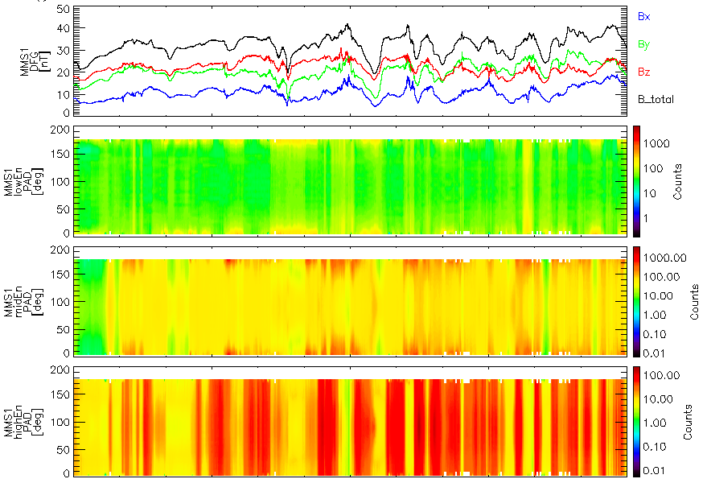
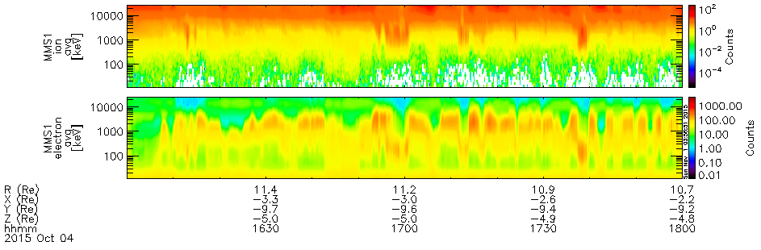
Oct. 4 – 16:00-18:00

Slide 8
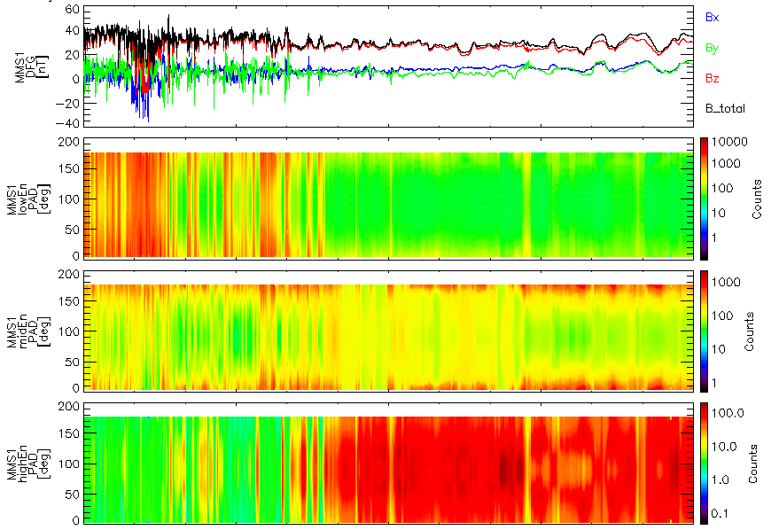
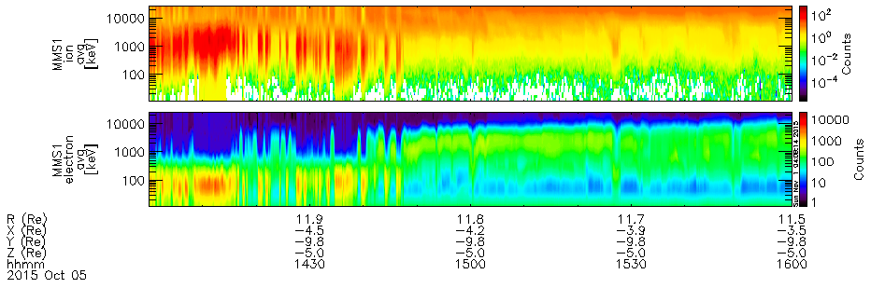
Oct. 5 – 14:00-16:00

Slide 9
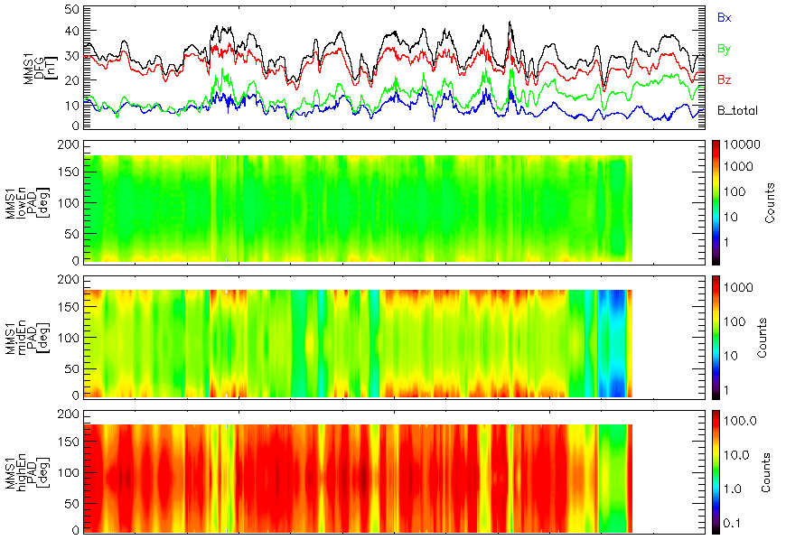
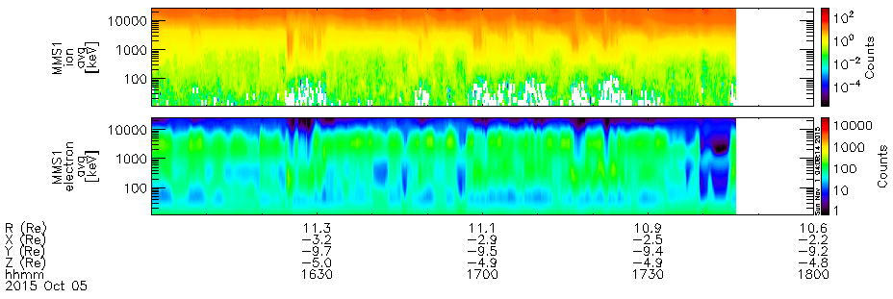
Oct. 5 – 16:00-18:00

Slide 10
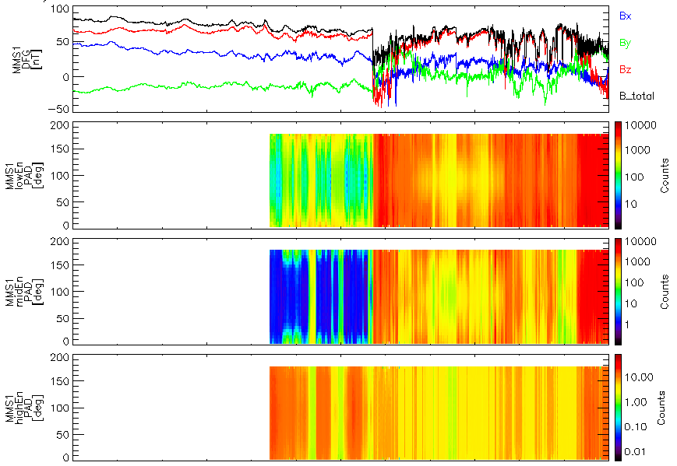
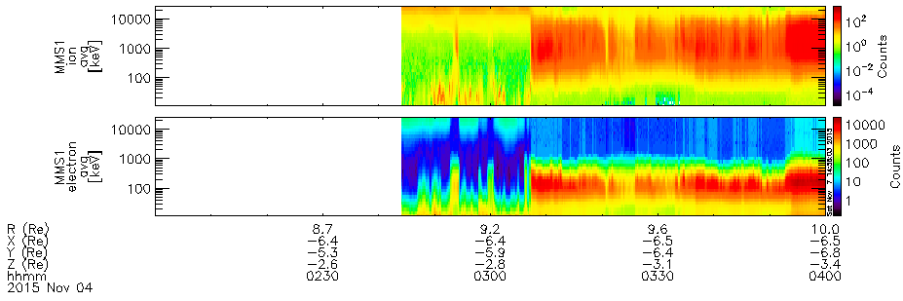
Nov 4 – 02:00-04:00

Slide 11
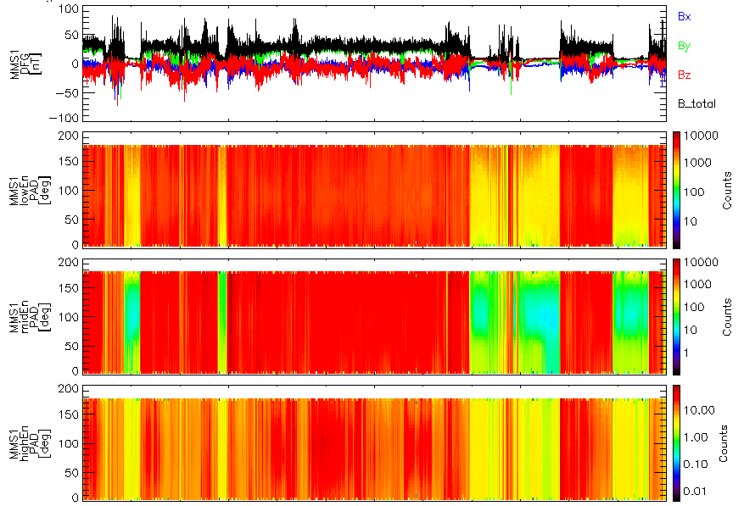
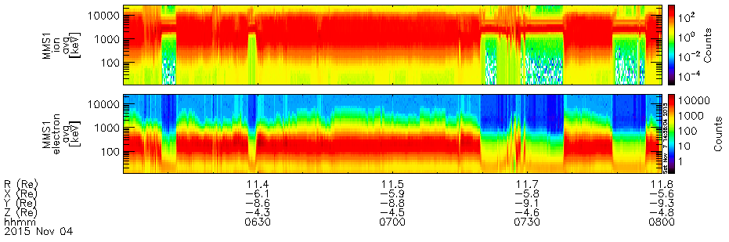
Nov 4 – 06:00-08:00

Slide 12
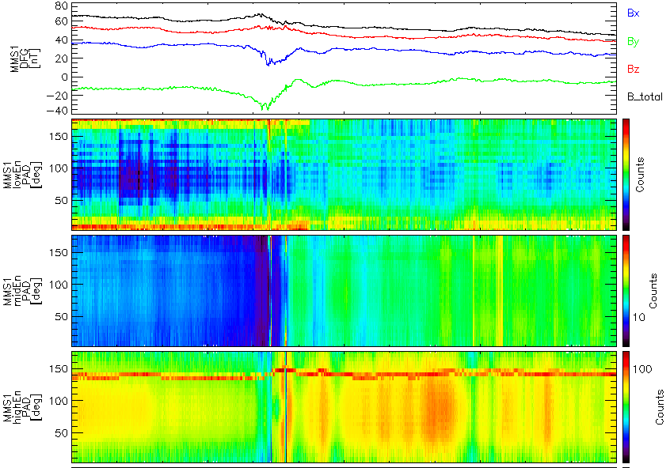
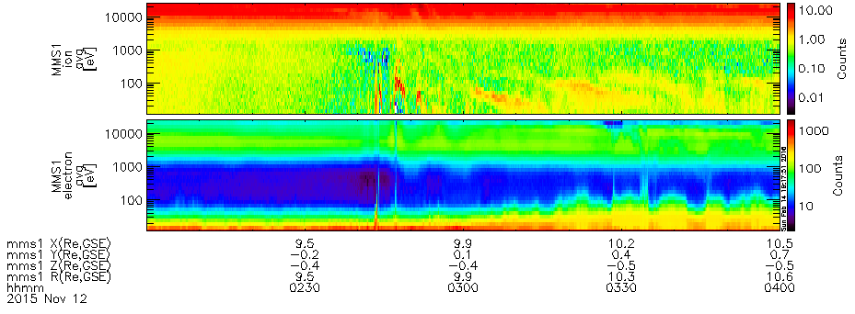
Nov 12 – 02:00-04:00

Slide 13
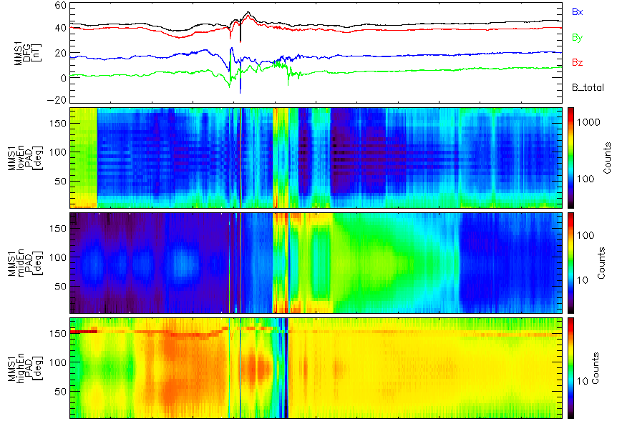
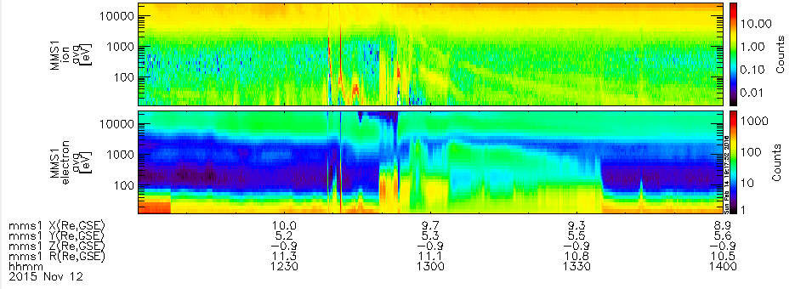
Nov 12 – 12:00-14:00

